Slide 1
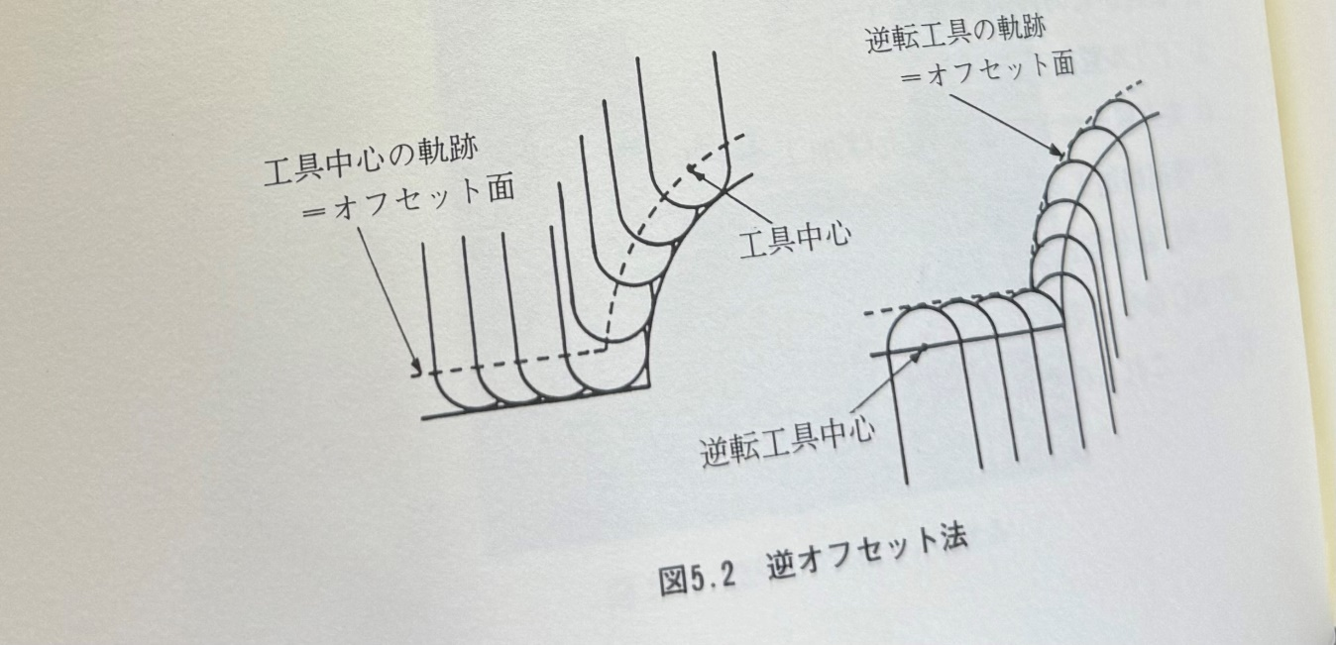
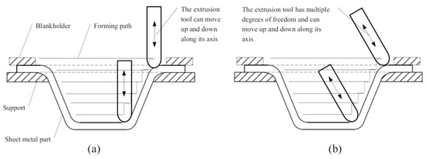

Slide 2
Offset Toolpath
Reverse Tool Center
Tool Center
Toolpath of the Test Shape

